Slide 1
Büchi Automata
Formal Systems (CS60030)
Pallab Dasgupta
Professor,
Dept. of Computer Sc & Engg

Slide 2
Lecture Overview
⇒ Motivation: Peterson’s Algorithm
ω-Regular Languages
Nondeterministic Büchi Automata (NBA)
NBA and ω-Regular Languages

Slide 3
Recap: Verifying regular safety properties
A safety property P is regular if bp(P) is a regular language
Thus, bad prefixes of P are recognizable by an NFA A
Checking TS |= P for regular P reduces to
checking a (simple) invariant on the product automaton TS ⊗ A
i.e., performing a simple depth-first search on TS ⊗A
Time and space complexity in O ( |TS| . |A|)
for more general properties we need automata accepting infinite words!

Slide 4
Peterson’s banking system
Person Left behaves as follows:
Person Right behaves as follows:
rq : wt : cs : | while true { . . . . . . b₁, x = true, 2; wait until(x == 1 || ¬ b₂) { . . . @account_{L} . . .} b₁ = false; . . . . . . } |  | rq : wt : cs : | while true { . . . . . . b₂, x = true, 1; wait until(x == 2 || ¬ b₁) { . . . @account_{R} . . .} b₂ = false; . . . . . . }

Slide 5
Is the banking system live?
x == 1 x == 2
b₁ = 0
b₂ = 0
b₁ = 1
b₂ = 1
x = 2
x = 1
b₂ = 1
b₁ = 0
b₂ = 0
b₁ = 1
b₂ = 1
x = 1
x = 1
x = 2
b₁ = 1
x = 2
x == 1
x == 2
If someone wants to update the account, does he ever get the opportunity to do so?
“always (req_{L} ⇒ eventually @account_{L}) ∧ always (req_{R} ⇒ eventually @account_{R})”

Slide 6
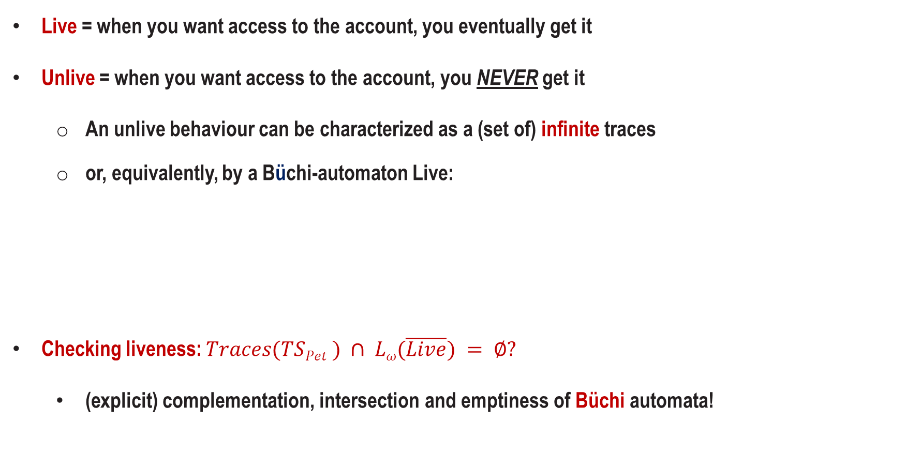
Is the banking system live (revisited)?
Live = when you want access to the account, you eventually get it
Unlive = when you want access to the account, you NEVER get it
An unlive behaviour can be characterized as a (set of) infinite traces
or, equivalently, by a Büchi-automaton Live:
Checking liveness: $Traces(TSPet ) ∩ Lω(\overline{Live}) = ∅?$
(explicit) complementation, intersection and emptiness of Büchi automata!
¬@account
true
true
req
@account

Slide 7
Lecture Overview
Motivation: Peterson’s Algorithm
⇒ ω-Regular Languages
Nondeterministic Büchi Automata (NBA)
NBA and ω-Regular Languages

Slide 8


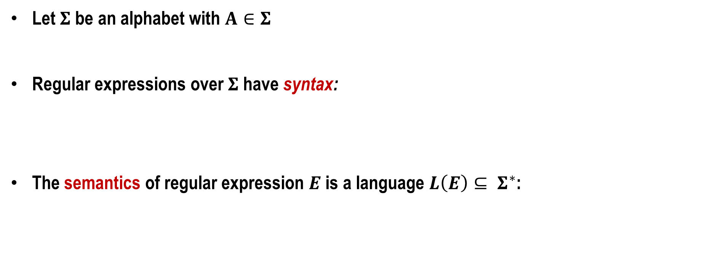


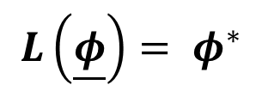

Regular expressions
Let $Σ$ be an alphabet with $A∈Σ$
Regular expressions over $Σ$ have syntax:
The semantics of regular expression $E$ is a language $L\left(E\right)⊆ Σ^{∗}$:
$$E ::=\underline{φ} | \underline{ε} | \underline{A} \left| E+E^{′} \right| E.E^{′} | E^{∗}$$
$$L\left(\underline{φ}\right)= φ^{∗}$$
$$L\left(\underline{ε}\right)= \left\{ε\right\}$$
$$L\left(\underline{A}\right)= \left\{A\right\}$$
$$L\left(E+E′\right)=L\left(E\right)∪L(E^{′})$$
$$L\left(E.E′\right)=L\left(E\right).L(E^{′})$$
$$L\left(E^{∗}\right)={L\left(E\right)}^{∗}$$

Slide 9
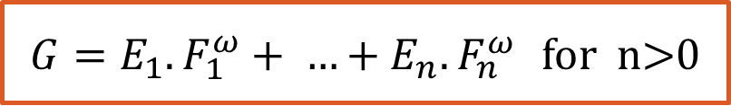
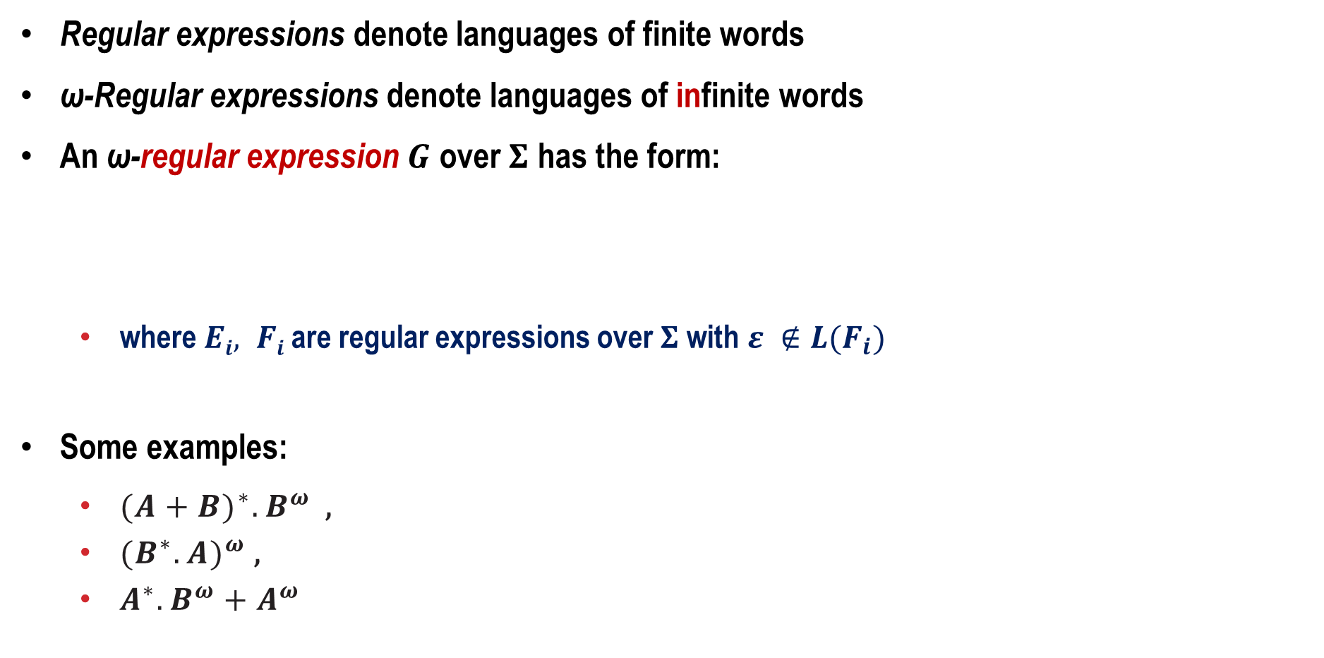
Syntax of ω-regular expressions
Regular expressions denote languages of finite words
ω-Regular expressions denote languages of infinite words
An ω-regular expression $G$ over $Σ$ has the form:
where $Ei, Fi$ are regular expressions over $Σ$ with $ε ∉L(F_{i})$
Some examples:
${(A+B)}^{∗}.B^{ω}$ ,
${(B^{∗}.A)}^{ω}$ ,
$A^{∗}.B^{ω}+A^{ω}$
$G=E_{1}.F_{1}^{ω}+ …+E_{n}.F_{n}^{ω}$ for n>0

Slide 10
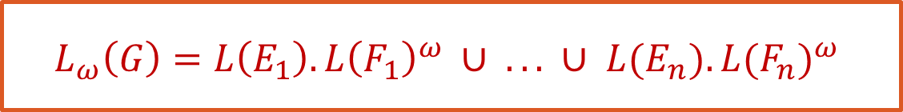
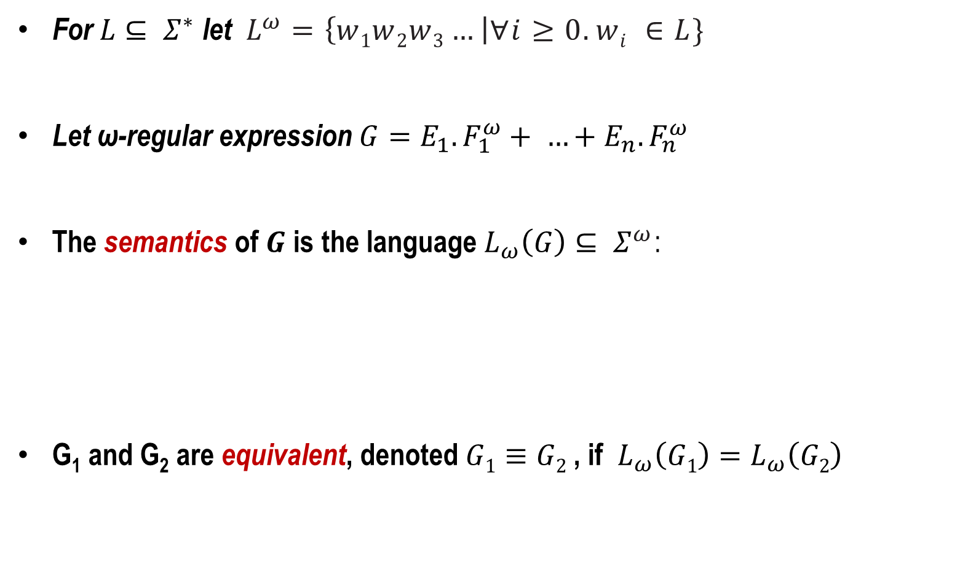
Semantics of ω-regular expressions
For $L⊆ Σ^{∗}$ let $L^{ω}=\left\{w1w2w3…\right|∀i≥0. wi ∈L\}$
Let ω-regular expression $G=E_{1}.F_{1}^{ω}+ …+E_{n}.F_{n}^{ω}$
The semantics of $G$ is the language$L_{ω}\left(G\right)⊆ Σ^{ω}$:
G₁ and G₂ are equivalent, denoted $G1≡G2$ , if $L_{ω}\left(G1\right)=L_{ω}\left(G2\right)$
$$L_{ω}\left(G\right)=L\left(E_{1}\right). {L\left(F_{1}\right)}^{ω} ∪ . . . ∪ L(E_{n}). {L(F_{n})}^{ω}$$

Slide 11

ω-Regular languages
$L$ is ω-regular if $L=L_{ω}\left(G\right)$ for some ω-regular expression $G$
Examples over $Σ=\{A,B\}$:
Language of all words with infinitely many As: $(B^{∗}.A)ω$
Language of all words with finitely many As:${(A+B)}^{∗}.Bω$
The empty language: $∅^{ω}$
ω-Regular languages are closed under $∪$ , $∩$ and complementation

Slide 12
ω-Regular safety properties
Definition:
LT property P over AP is ω-Regular if
P is an ω-regular language over the alphabet 2^{AP}
Or, equivalently:
LT property P over AP is ω-Regular if
P is a language accepted by a nondeterministic Büchi automaton over 2^{AP}

Slide 13
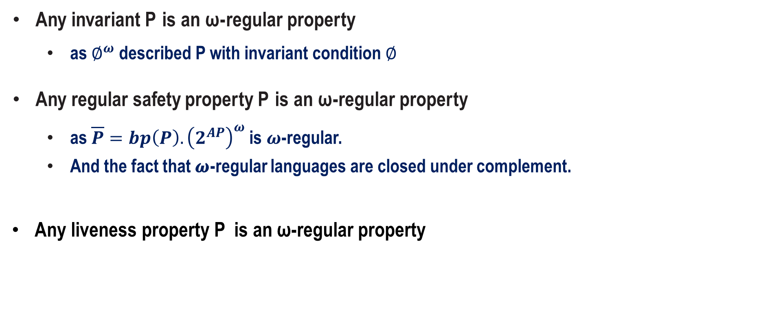
Abstract examples of ω-regular properties
Any invariant P is an ω - regular property
as $∅^{ω}$ described P with invariant condition $∅$
Any regular safety property P is an ω -regular property
as $\overline{P}=bp\left(P\right).{\left(2^{AP}\right)}^{ω}$ is $ω$-regular.
And the fact that 𝝎-regular languages are closed under complement.
Any liveness property P is an ω-regular property

Slide 14
Concrete ω-regular properties

Slide 15
Lecture Overview
Motivation: Peterson’s Algorithm
ω-Regular Languages
⇒ Nondeterministic Büchi Automata (NBA)
NBA and ω-Regular Languages

Slide 16
Nondeterministic Büchi automata
NFA (and DFA) are incapable of accepting infinite words
Automata on infinite words
suited for accepting ω-regular languages
We consider nondeterministic Büchi automata (NBA)
Accepting runs have to “check” the entire input word ⇒ are infinite
acceptance criteria for infinite runs are needed
NBA are like NFA, but have a distinct acceptance criterion
one of the accept states must be visited infinitely often

Slide 17
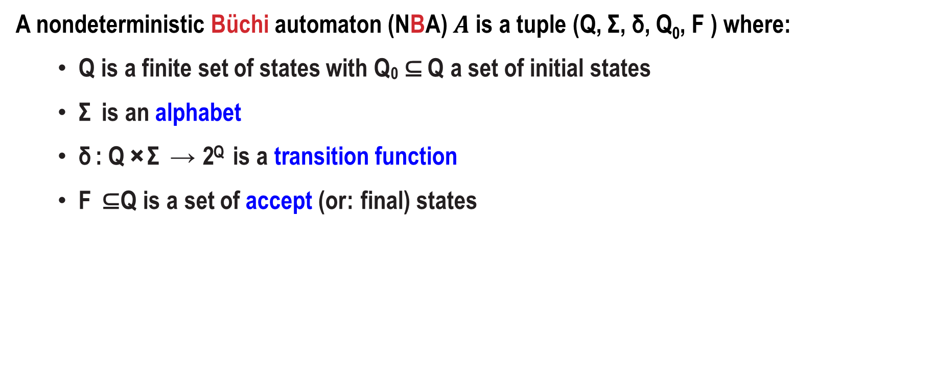
Büchi automata
A nondeterministic Büchi automaton (NBA) $A$ is a tuple (Q, Σ, δ, Q₀, F ) where:
Q is a finite set of states with Q₀ ⊆ Q a set of initial states
Σ is an alphabet
δ : Q × Σ → 2^{Q} is a transition function
F ⊆ Q is a set of accept (or: final) states

Slide 18
An example NBA

Slide 19
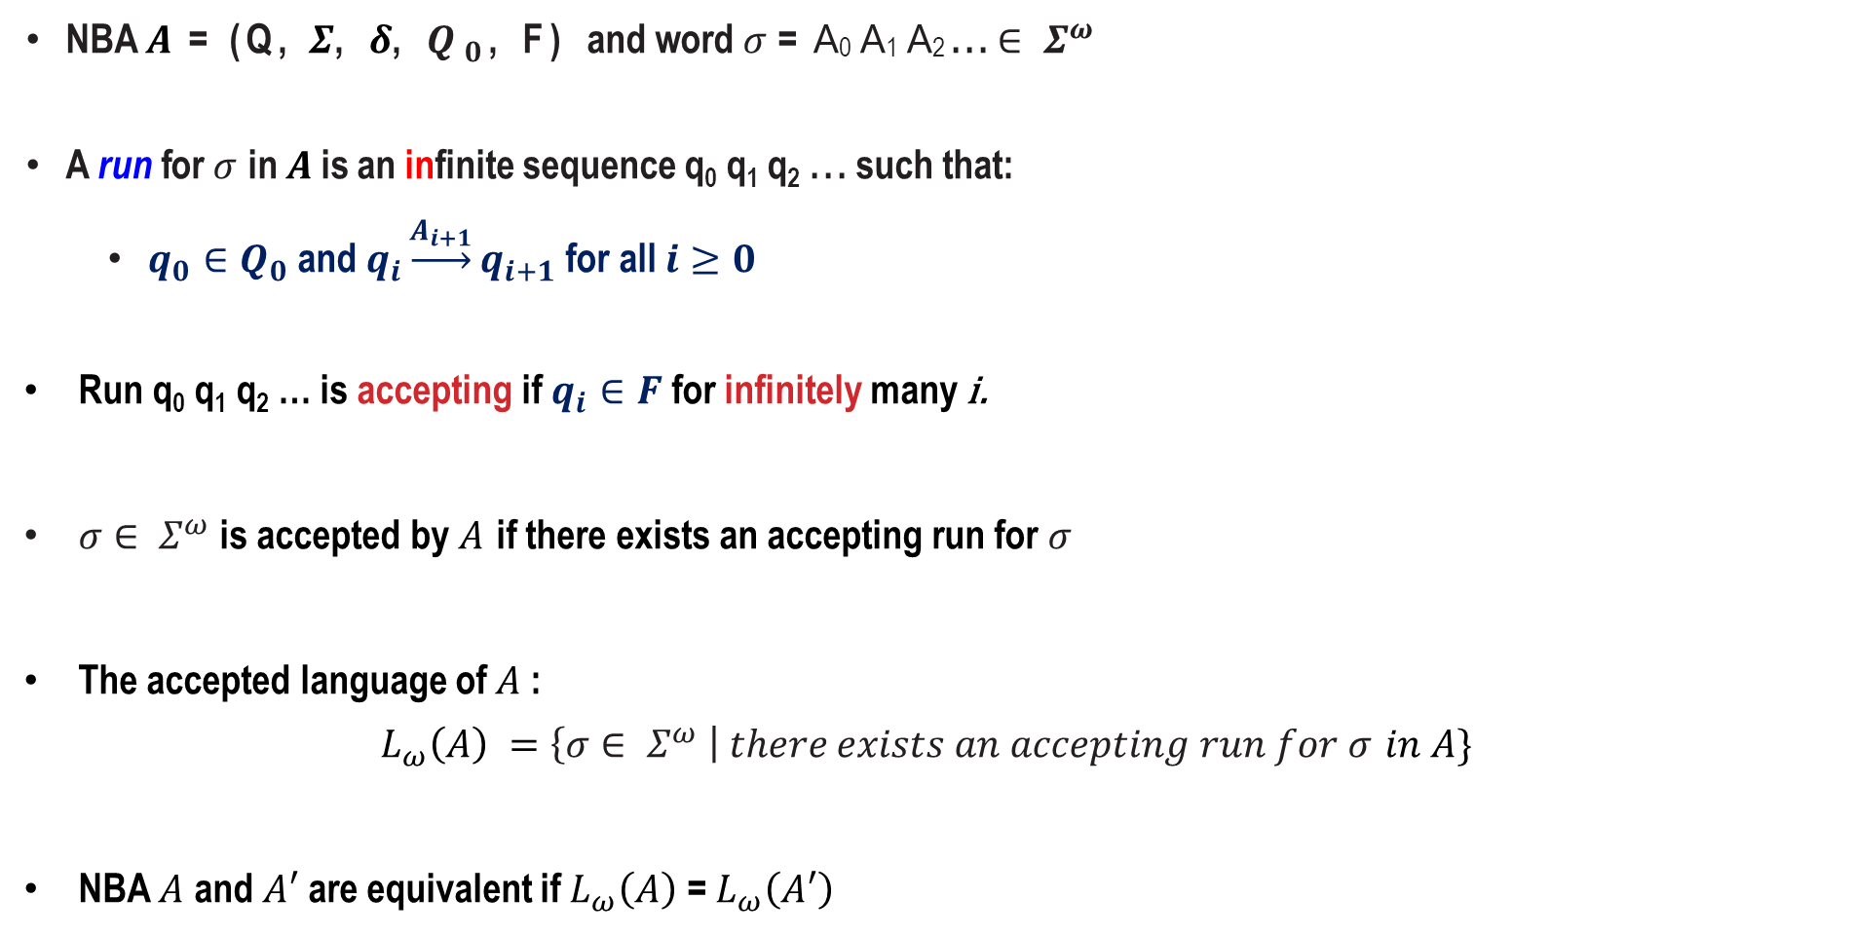
Language of an NBA
NBA $A$ = (Q, $Σ$, $δ$, $Q_{0}$, F) and word $σ$ = A₀ A₁ A₂ . . . $∈ Σ^{ω}$
A run for $σ$ in $A$ is an infinite sequence q₀ q₁ q₂ . . . such that:
$q_{0}∈Q_{0}$ and $q_{i}\underset{→}{A_{i+1}}q_{i+1}$ for all $i≥0$
Run q₀ q₁ q₂ … is accepting if $q_{i}∈F$ for infinitely many i.
$σ∈ Σ^{ω}$ is accepted by $A$ if there exists an accepting run for $σ$
The accepted language of $A$:
$$L_{ω}\left(A\right) =\left\{σ∈ Σ^{ω} \right| there exists an accepting run for σ in A\}$$
NBA $A$ and $A′$ are equivalent if $L_{ω}\left(A\right)$ = $L_{ω}\left(A′\right)$

Slide 20
Example runs and accepted words

Slide 21
Some NBA for ω-regular properties

Slide 22
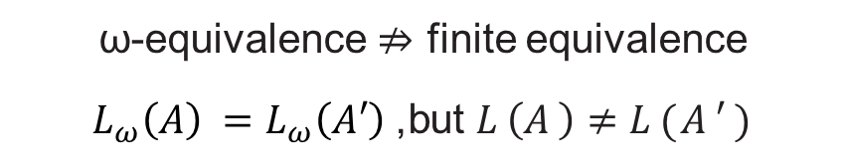
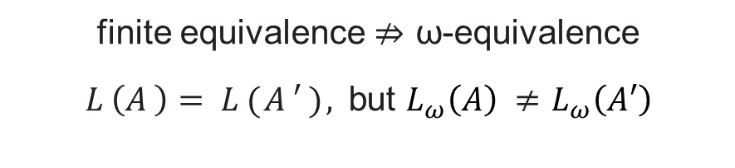
NBA versus NFA
a
a
a
a
a
a
a
a
finite equivalence $⇏$ ω-equivalence
$L\left(A\right)=L(A′),$but $L_{ω}\left(A\right)$ $≠$ $L_{ω}\left(A′\right)$
ω-equivalence $⇏$ finite equivalence
$L_{ω}\left(A\right)$ $=L_{ω}\left(A′\right)$, but $L\left(A\right)≠L(A′)$

Slide 23
Lecture Overview
Motivation: Peterson’s Algorithm
ω-Regular Languages
Nondeterministic Büchi Automata (NBA)
⇒ NBA and ω-Regular Languages

Slide 24
NBA and ω-regular languages
The class of languages accepted by NBA
agrees with the class of ω-regular languages.
any ω-regular language is recognized by an NBA
for any NBA A, the language L_{ω}(A) is ω-regular

Slide 25
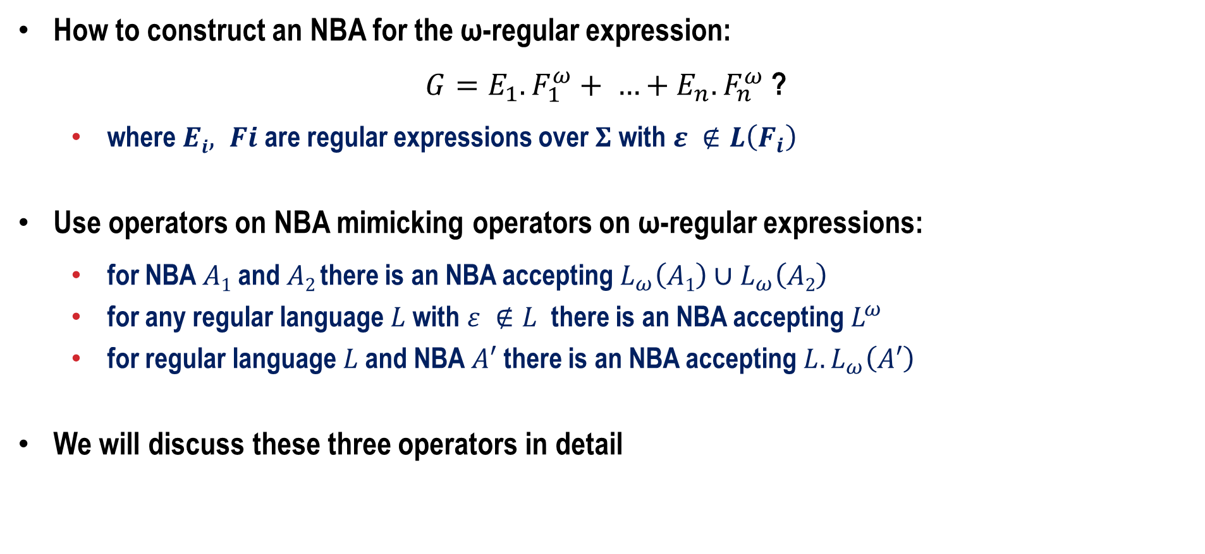
For any ω-regular language there is an NBA
How to construct an NBA for the ω-regular expression:
$G=E_{1}.F_{1}^{ω}+ …+E_{n}.F_{n}^{ω}$ ?
where $Ei, Fi$ are regular expressions over $Σ$ with $ε ∉L\left(F_{i}\right)$
Use operators on NBA mimicking operators on ω-regular expressions:
for NBA $A1$ and $A2$there is an NBA accepting $L_{ω}\left(A1\right)∪L_{ω}\left(A2\right)$
for any regular language $L$ with $ε ∉L$ there is an NBA accepting${ L}^{ω}$
for regular language $L$ and NBA $A′$ there is an NBA accepting ${L.L}_{ω}\left(A′\right)$
We will discuss these three operators in detail

Slide 26
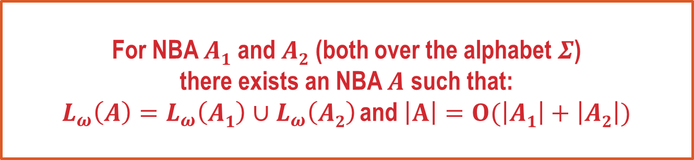
Union of NBAs
For NBA $A1$ and $A2$ (both over the alphabet $Σ$)
there exists an NBA $A$ such that:
$L_{ω}\left(A\right)=L_{ω}\left(A1\right)∪L_{ω}\left(A2\right)$and $\left|A\right|=O(\left|A1\right|+\left|A2\right|)$

Slide 27
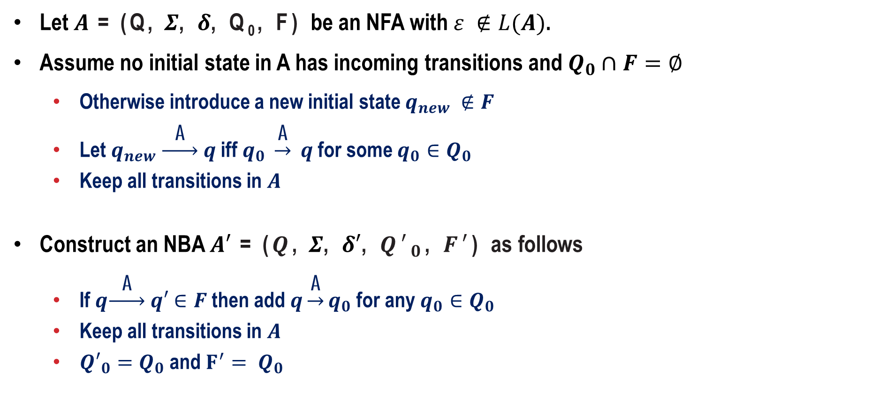
Definition of ω-operator for NFA
Let $A$ = (Q, $Σ$, $δ$, Q₀, F) be an NFA with $ε ∉L(A)$.
Assume no initial state in A has incoming transitions and $Q_{0}∩F=∅$
Otherwise introduce a new initial state $q_{new} ∉F$
Let $q_{new} \underset{→}{ \text{A} } q$ iff $q_{0} \underset{→}{\text{A}} q$ for some $q_{0}∈Q_{0}$
Keep all transitions in $A$
Construct an NBA $A′$ = ($Q$, $Σ$, $δ′$, ${Q′}_{0}$, $F′$) as follows
If $q\underset{→}{ \text{A} } q′$ $∈F$ then add $q\underset{→}{\text{A}}q_{0}$ for any $q_{0}∈Q_{0}$
Keep all transitions in $A$
${Q′}_{0}=Q_{0}$ and $F^{′}= Q_{0}$

Slide 28
Example for ω-operator for NFA
A
A
q ₀
B
q ₁
A
B
qnew
q
0
B
q
1
B
A
A
q ₀
B
B
q ₁
qnew
B
From an NFA accepting A∗B to an NBA accepting (A∗B)^{ω}

Slide 29
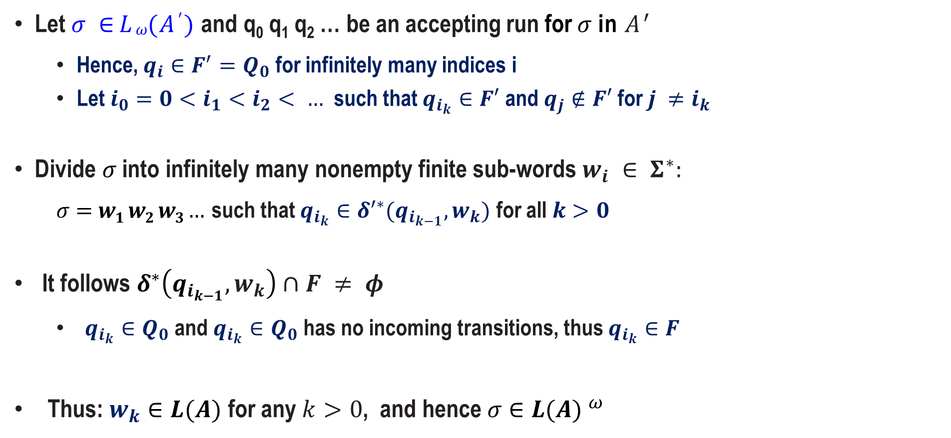
Proof of $L_{ω}\left(A^{′}\right)\text{⊆}$ ${L(A)}^{ω}$
Let $σ ∈ Lω(A′)$ and q₀ q₁ q₂ … be an accepting run for $σ$ in $A^{′}$
Hence, $q_{i}∈F^{′}=Q_{0}$ for infinitely many indices i
Let $i_{0}=0<i_{1}<i_{2}< …$ such that $q_{i_{k}}∈F′$ and $q_{j}∉F′$ for $j ≠i_{k}$
Divide $σ$ into infinitely many nonempty finite sub-words $w_{i} ∈ Σ^{∗}:$
$σ=w1 w2 w3…$ such that $q_{i_{k}}∈δ^{′∗}(q_{i_{k−1}},w_{k})$ for all $k>0$
It follows $δ^{∗}\left(q_{i_{k−1}}, w_{k}\right)∩F ≠ φ$
$q_{i_{k}}∈Q_{0}$ and $q_{i_{k}}∈Q_{0}$ has no incoming transitions, thus $q_{i_{k}}∈F$
Thus: $w_{k}∈L(A)$ for any $k>0$, and hence $σ∈{L(A) }^{ω}$

Slide 30
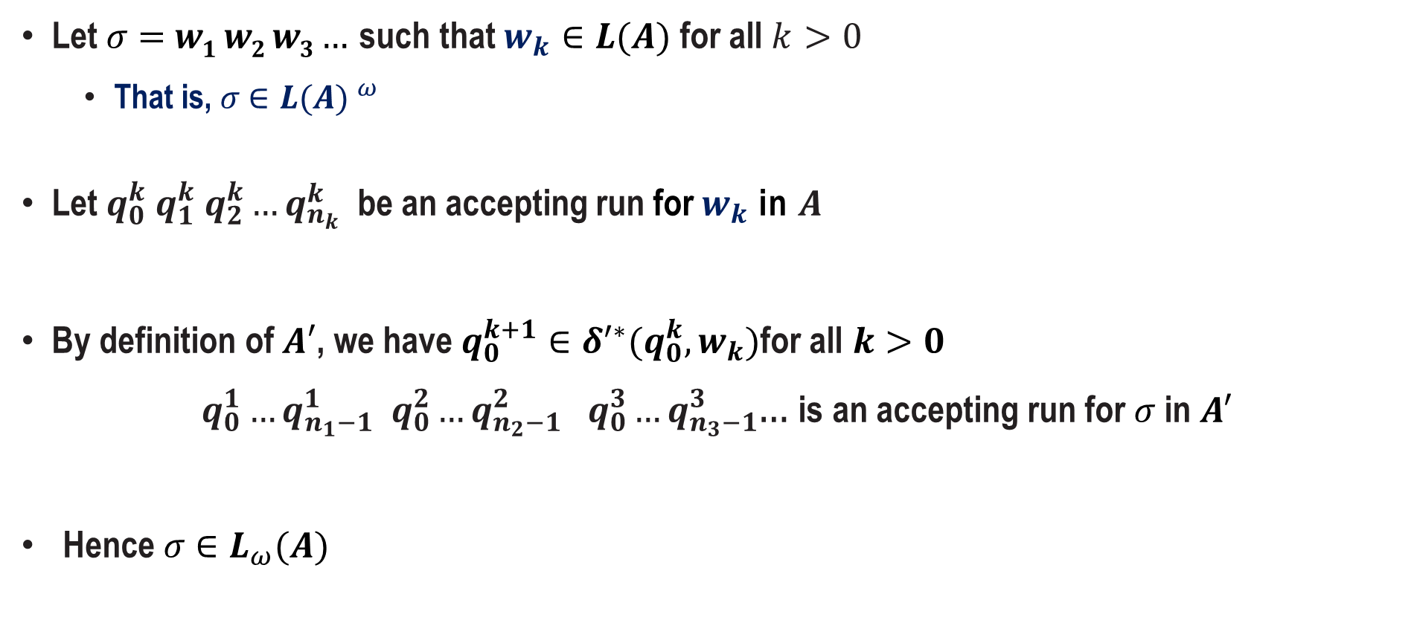
Proof of $L_{ω}\left(A^{′}\right)⊇$ ${L(A)}^{ω}$
Let $σ=w1 w2 w3…$ such that $w_{k}∈L(A) \text{for} \text{a}\text{ll} k>0$
That is, $σ∈{L(A) }^{ω}$
Let $q_{0}^{k} q_{1}^{k} q_{2}^{k}…q_{n_{k}}^{k}$ be an accepting run for $w_{k}$ in $A$
By definition of $A′$, we have $q_{0}^{k+1}∈δ^{′∗}(q_{0}^{k},w_{k})$for all $k>0$
$q_{0}^{1}…q_{n_{1}−1}^{1} q_{0}^{2}…q_{n_{2}−1}^{2} q_{0}^{3}…q_{n_{3}−1}^{3}$… is an accepting run for $σ$ in $A′$
Hence $σ∈L_{ω}(A)$

Slide 31
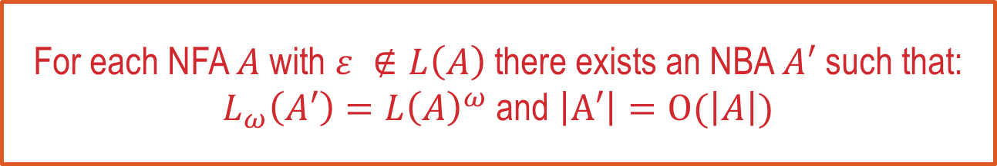
Summarizing: ω-operator for NFA
For each NFA $A$ with $ε ∉L\left(A\right)$ there exists an NBA $A′$ such that:
$L_{ω}\left(A′\right)={L\left(A\right)}^{ω}$ and $\left|A′\right|=O(\left|A\right|)$

Slide 32
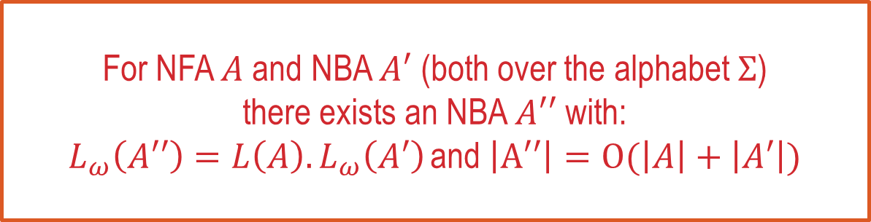
Concatenating an NFA and an NBA
For NFA $A$ and NBA $A′$ (both over the alphabet $Σ$)
there exists an NBA $A′′$ with:
$L_{ω}\left(A′′\right)=L\left(A\right).L_{ω}\left(A′\right)$and $\left|A′′\right|=O(\left|A\right|+\left|A′\right|)$

Slide 33
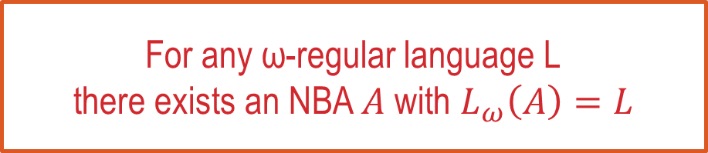
Summarizing the results so far
For any ω-regular language L
there exists an NBA $A$ with $L_{ω}\left(A\right)=L$

